Slide 1
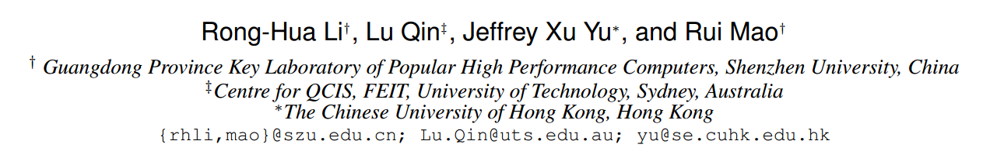
Efficient and Progressive Group Steiner Tree Search
SIGMOD-2016
TianzhuWei
2016/10/??

Slide 2
Contents
Problem definition
Exist Solution
Our Solution
Experiments
Thinking

Slide 3
The GST Problem
1
1
Given a weighted and labelled ( S ) graph G ;
A subset of labels P ( P ⊆ S ) ;
4
4
4
4
4
4
1
1
1
1
Find the minimum weight connected tree from G that includes all the labels in P
v1
v2
v3
v4
Notes:
边加权 ST 问题
每一个结点都有含有多个标签
给定一个查询标签集合P

Slide 4
Exist Solution
The parameterized DP algorithm
v
T(v,X)
The optimal weight of the state (v , X ) could be obtained by :
u
T(u,X)
a ) Edge growing operation
V
T(v,X)
X
b ) Tree merging operation
X
X = X₁ ∪ X₂
(X₁ ∩ X₂=NULL)
T(v,X₁)
v
v
T(v,X₂)
X₁
X₂
Notes:
state (v , X ) 表示以 v 为根，含有标签集合 X 的树

Slide 5
v7
Exist Solution
The parameterized DP algorithm
4
v5
v7
v5
v5
v6
v6
v7
v7
v8
v8
v5
Priority Queue
1
1
1
1
4
4
4
4
1
v1
v2
v3
1
4
1
1
v9
v4
v1
v1
v1
v2
v3
v4
v1
v2
v3
v4
v1
a) maintain the states (e.g., (v , X ))
b) the weight of a state is the priority of that state
1
v7
v8
1
Initially , if v contains keywords p then v enqueueT(v,p) into Q
a ) Edge growing operation
v5
v5
1
1
4
Single node tree are with a zero cost
T ( v , p ) = 0
4
4
4
4
4
4
4
v
b ) Tree merging operation
v
v5
v1
v2
v6
1
1
1
1
1
1
1
1
1
4
1
v1
v2
v3
v4
Limitations:
a) the time complexity
b) the algorithm only generates a solution when it terminates
v1
v2
v3
v4
Notes:
优先队列
按照入队子树的权重和进行排列，权重越小，优先值越高
V1 v2 v3 v4 拥有我们给的查询的标签
局限：
时间复杂度 当给定的查询关键字个数大于8个时（当处理比较大的图时）就已经不能得出结果，同时也非常占用空间
我感觉不能算是缺点 只有当程序结束时才能得到结果。

Slide 6

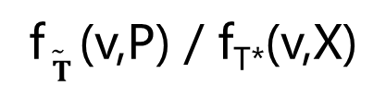


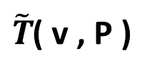

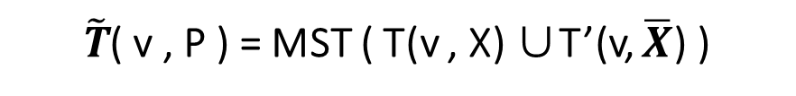

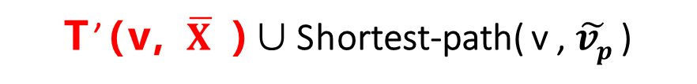


Priority Queue
a set D to maintain all the states
that have been computed
The Basic algorithm
$\tilde{T}$( v , P )
v1
v2
v3
v4
Preprocessing
a ) Edge growing operation
1
1
create a virtual node $\tilde{vp}$ , for a label p ∈ P ;
create an undirected edge( $\tilde{vp}$ , v ) with zero weight for each v ∈ V that includes a label p ;
compute the single-source shortest path from $\tilde{vp}$ to all the other nodes in the graph G.
b ) Tree merging operation
$$\overline{X}= P\backslash X$$
T(v,X )
T’(v, $\overline{X}$ )
4
4
4
4
4
4
approximation ratio
1
1
1
1
$\tilde{T}$( v , P ) = MST ( T(v , X) ∪T’(v, $\overline{X}$) )
f$\tilde{ T}$ (v,P) / f_{T*}(v,X)
T’(v, $\overline{X}$ )∪Shortest-path( v , $\tilde{vp}$ )
v1
v2
v3
v4
$\tilde{vp}$1
$\tilde{vp}$2
$\tilde{vp}$3
$\tilde{vp}$4
Notes:
使用 Dijkstra 方法求解 $\tilde{vp}$ 到其它 V 结点的最短路径
T’ ( v , $\overline{X}$) 将v 到$\overline{X}$ 虚拟结点的最短路径进行合并构成一棵树
然后将 T(v, X)与 T’ ( v , $\overline{X}$) 进行合并形成的最小生成树（MST）
这样获得一个可行解
当我们再进行 边添加 子树合并时就要进行 增长之后的 权重和是否小于 Best的权重，如果大于就舍弃不再进行操作
注意我们会用一个 D 来保存已经求得的状态的最优
注意合并时 X 与X- 不能有交集

Slide 7
The PrunedDP algorithm
u
Optimal-Tree Decomposition Theorem
Recall that in the Basic algorithm
To obtain the optimal solution f∗(P) for a query P , the algorithm must compute the optimal weights of all the intermediate states that are smaller than sub-optimal solutions .
For T*(P ) always exists a node u ∈ T* (P) :
the T*(P ) rooted at u has k (k ≥ 1) subtrees T1 , T2 , …Tk;
each subtree Ti has a weight smaller than f∗ (P) / 2 .
v1
v2
……
vk
T1
T2
T3
compute all the optimal subtrees that have weights smaller than f*(P )/2
merge the results obtained from the first stage to get the optimal tree.
Notes:
Assume that each edge in the graph G has a positive weight.
定理

Slide 8
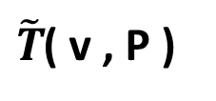
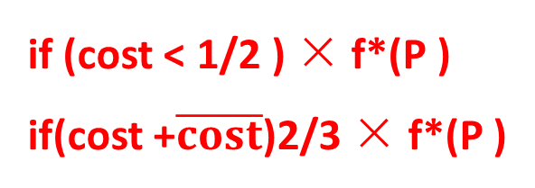
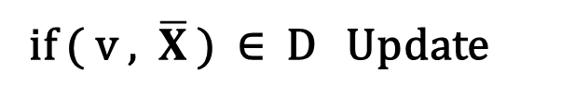
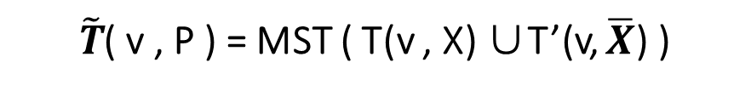
The PrunedDP algorithm
Priority Queue
{ a set D }
$\tilde{T}$( v , P )
Conditional Merging Theorem
v1
v2
v3
v4
merge two subtrees T (v, X ) and T (v, X’ ) for X’⊂ P \X only when
the total weight of these two subtrees is no larger than 2/3 × f*(P )
Optimal-Tree Decomposition Theorem
if (cost < 1/2 ) × f*(P )
if(cost +$\overline{cost}$)2/3 × f*(P )
if ( v , $\overline{X}$ ) ∈ D Update
$\tilde{T}$( v , P ) = MST ( T(v , X) ∪T’(v, $\overline{X}$) )
Notes:
这个定理我估计作者是偶然猜测出来的，证明很马虎。。。。。cry...s
大于 2/3 f*（P）的状态不需要树合并操作来进行
通过两个定理来减少了中间状态的求解次数 ，注意是 减少了求解次数

Slide 9
The PrunedDP++ algorithm
THE PROGRESSIVE A* ALGORITHM

Slide 12
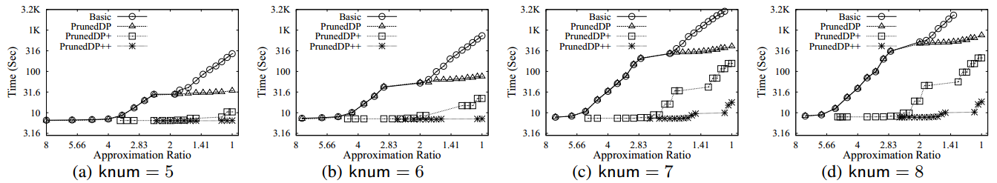
Query Processing Time vs. Approximation Ratio: Vary Number of Labels (knum) on DBLP
Experiments
Notes:
查询的关键字个数变化时

Slide 13
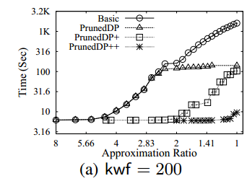
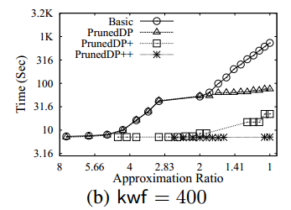
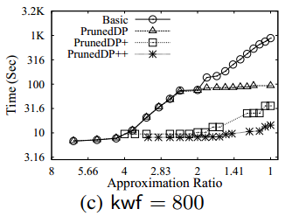
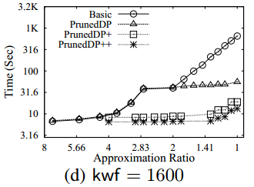
Query Processing Time vs. Approximation Ratio: Vary Label Frequency (kwf ) on DBLP

Slide 14
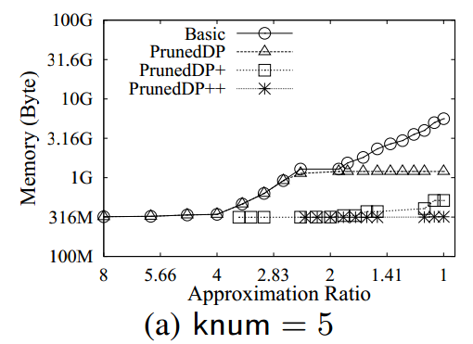
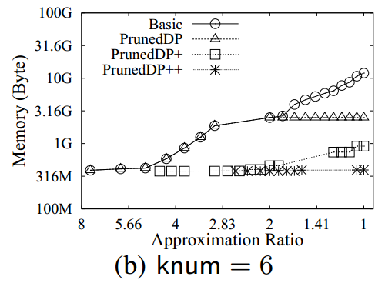
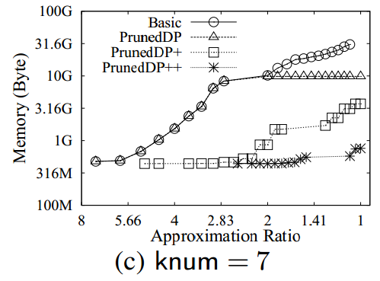
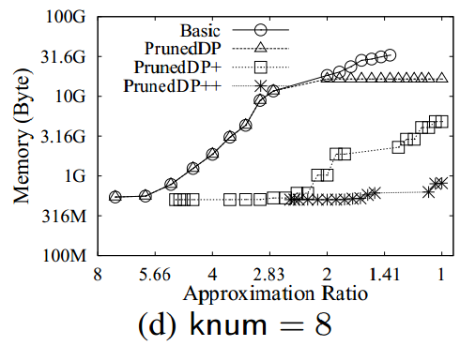
Memory Overhead vs. Approximation Ratio: Vary Number of Labels (knum) on DBLP

Slide 15
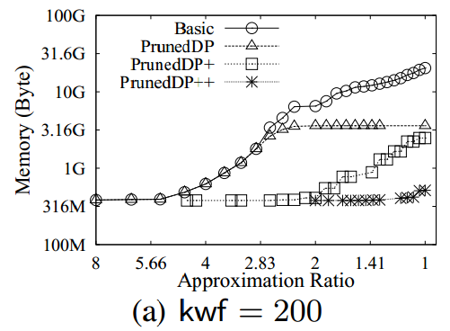
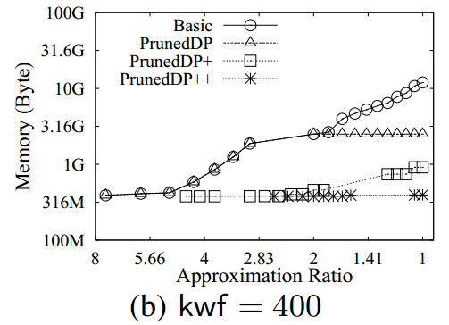
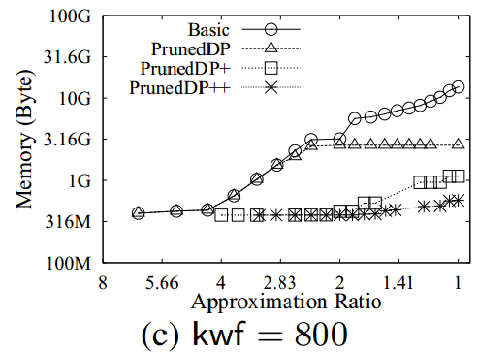
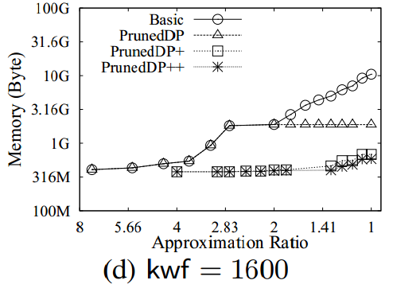
Memory Overhead vs. Approximation Ratio: Vary Label Frequency (kwf ) on DBLP

Slide 16
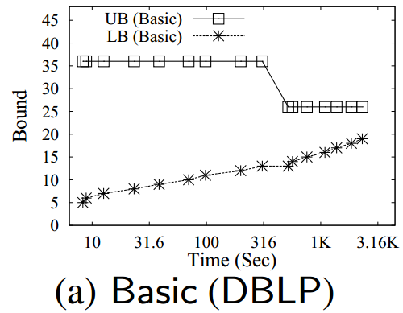
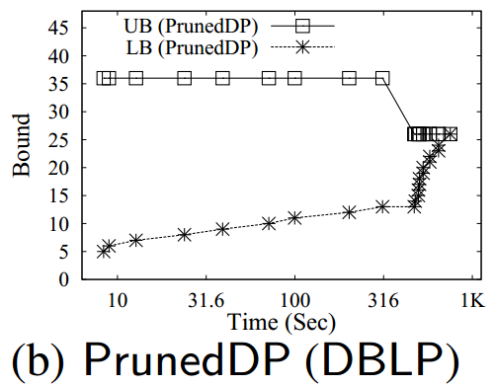
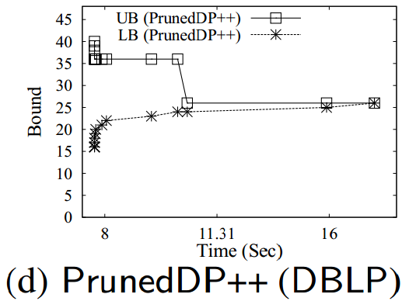
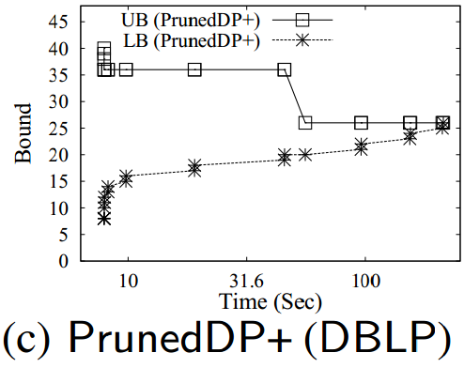
Progressive Performance Testing (knum = 8; kwf = 400)

Slide 17
Thanks

